Slide 1
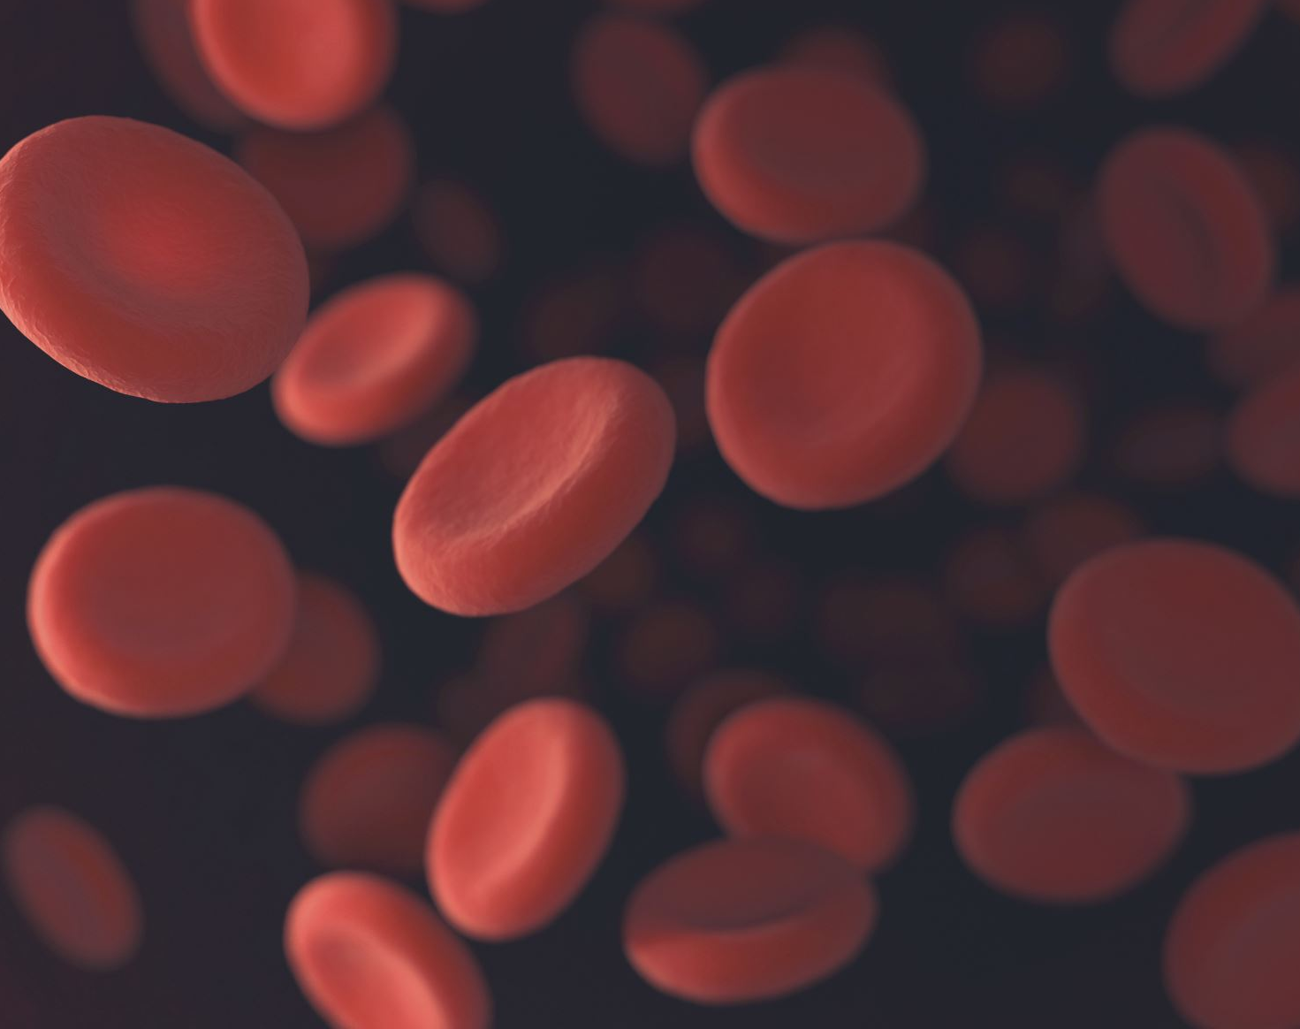
Complete Blood Profile
ES3315 - ES PROJECT
Challa Vishweshwar – ES22BTECH11007
Badavath Srikanth – ES22BTECH11004
R Kiran Kumar – ES22BTECH11030

Slide 2
Project Goal
To count RBCs, WBCs, Platelets, and estimate volume of RBCs using digital image processing and machine learning.

Slide 3
What We’ve Done So Far
Completed ML model (YOLO-based) – detects RBCs, WBCs, Platelets
Model performs well on preprocessed images,BCCD dataset and random stained images from online.
Defined experimental protocol and apparatus
Collected few initial samples
Next: start full-scale image collection + compare with CBC

Slide 4
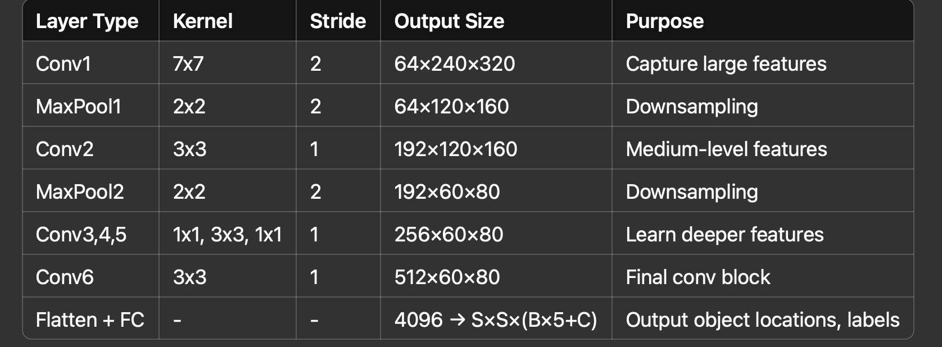
Machine Learning Model
Trained a YOLO-based model to detect RBCs, WBCs, and Platelets
Achieved promising results on BCCD dataset and random data from online.
Next steps:
Test on newly collected images
Extract bounding boxes → Measure size → Volume estimation
WBC sub-type classification (lymphocytes, monocytes, etc.)

Slide 5
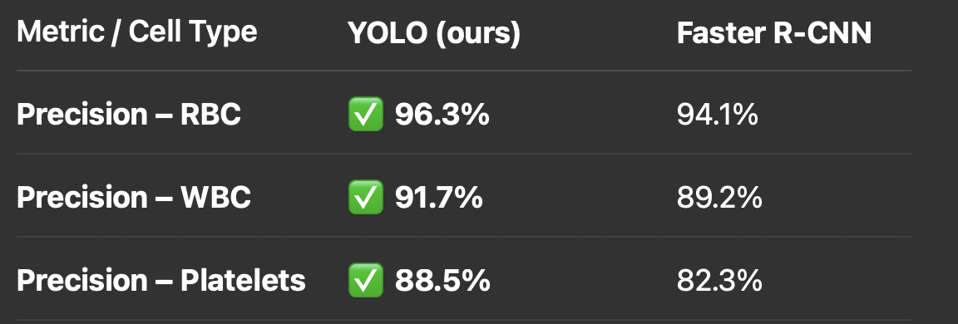
Model Performance Comparison of the 2 models we have built

Slide 6
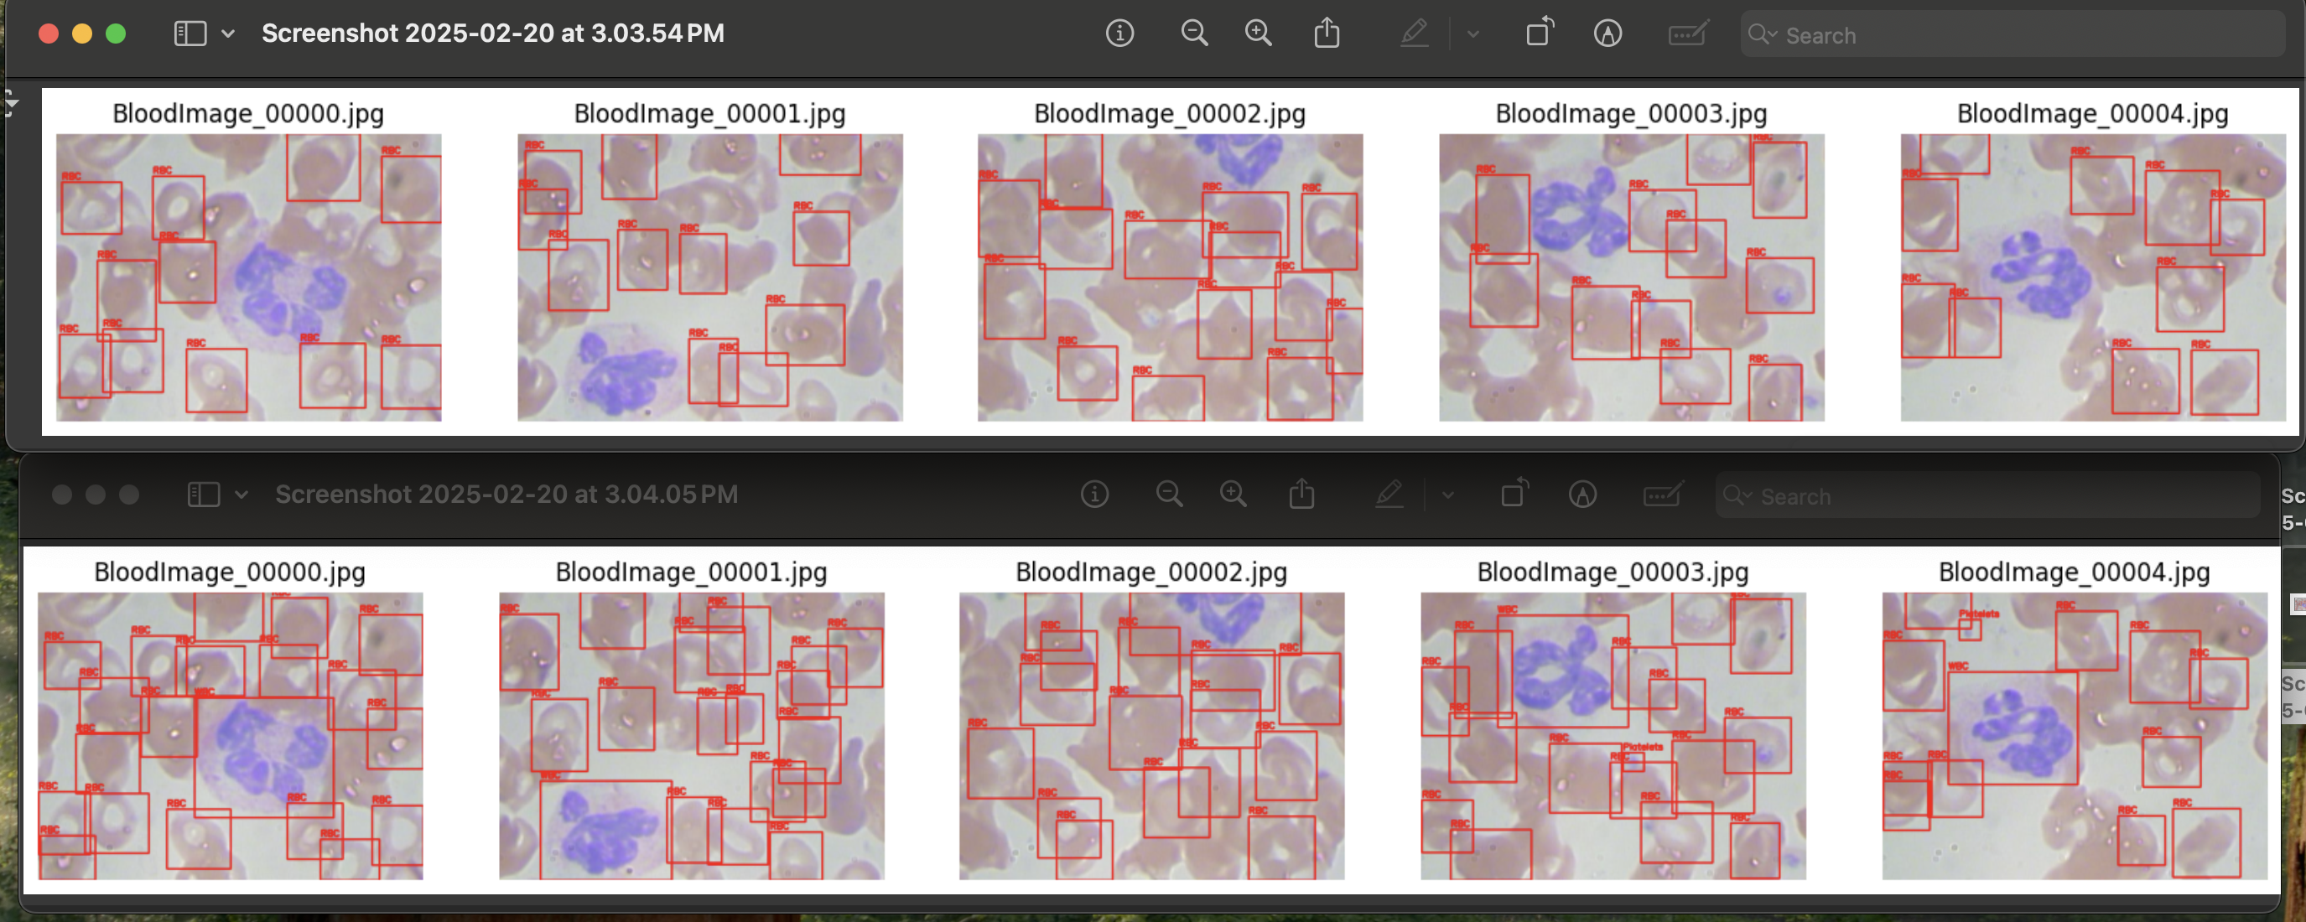
Data we used for training

Slide 7
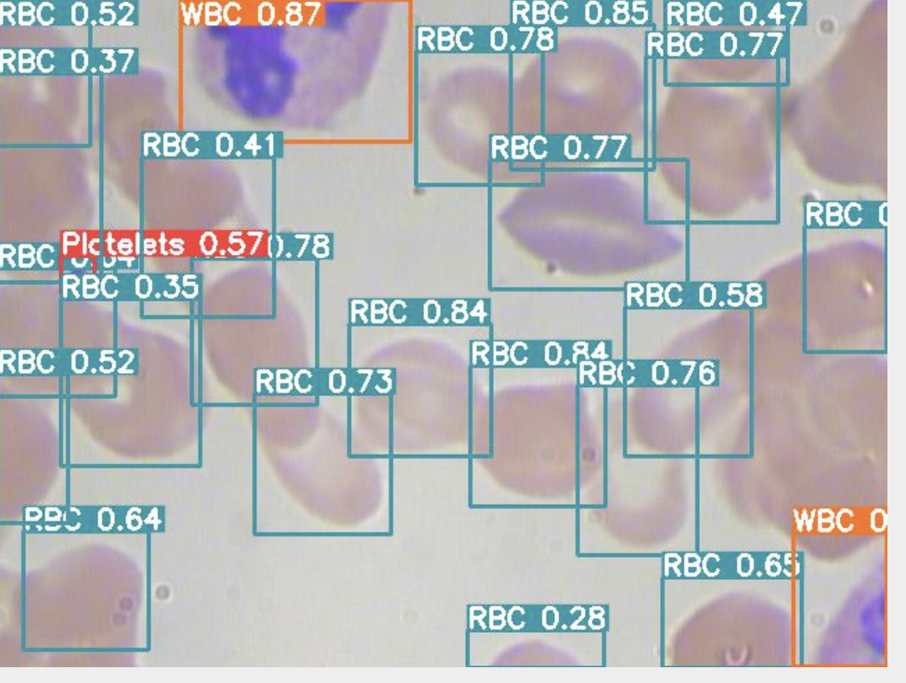
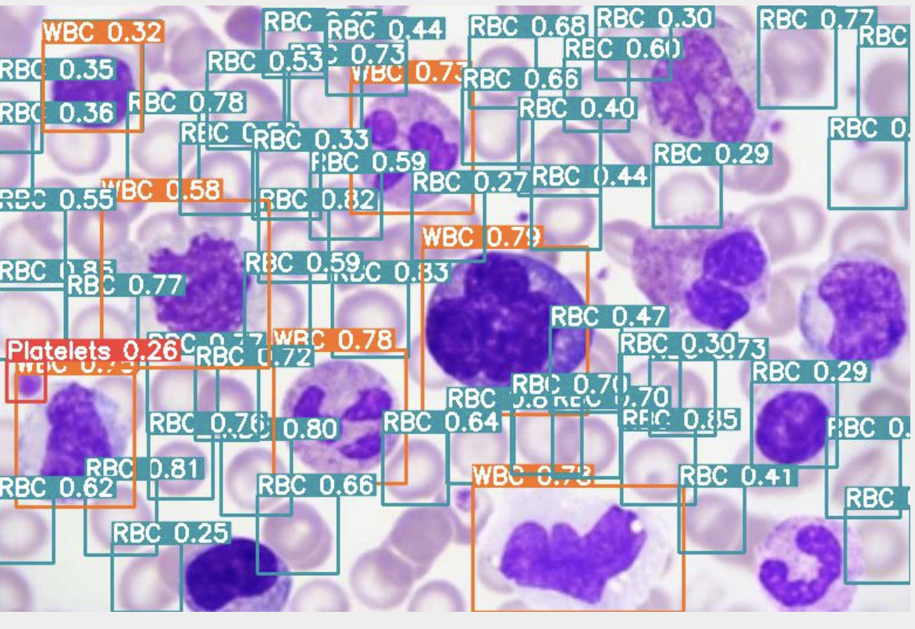
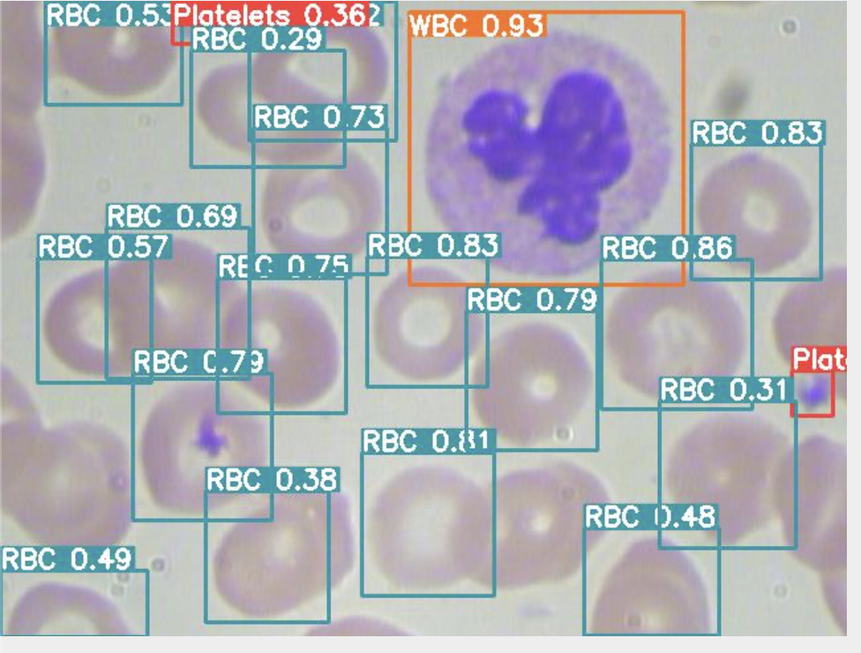
Results we got while testing

Slide 8
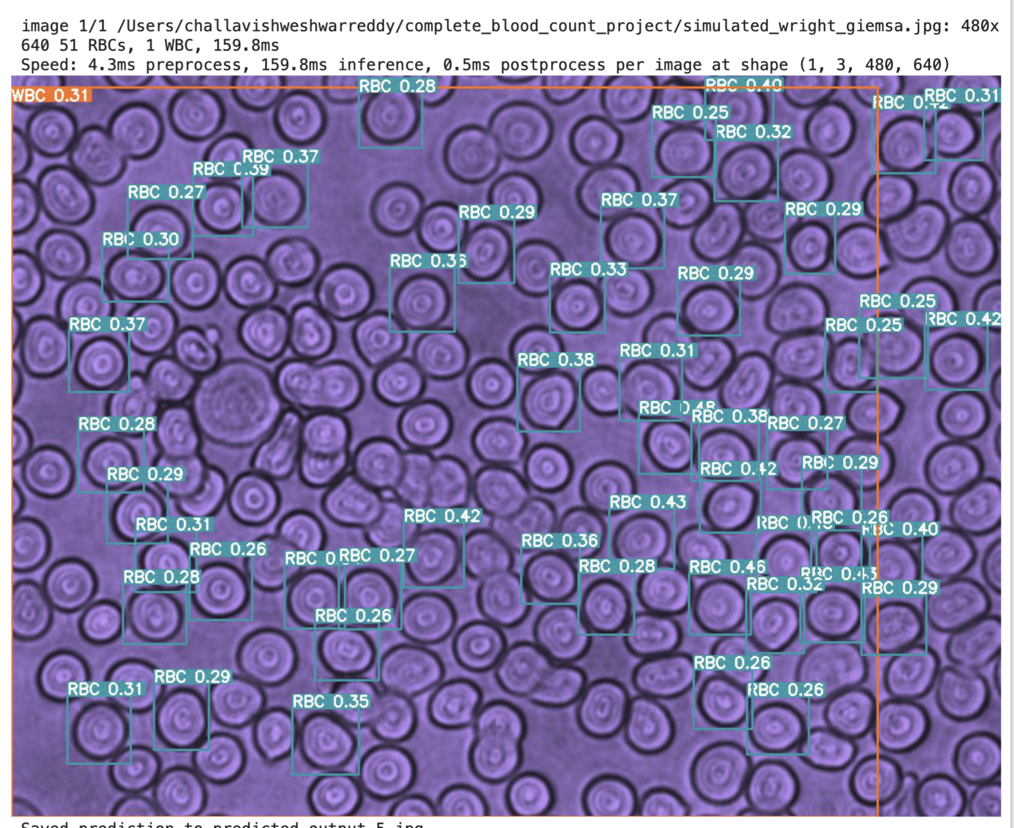
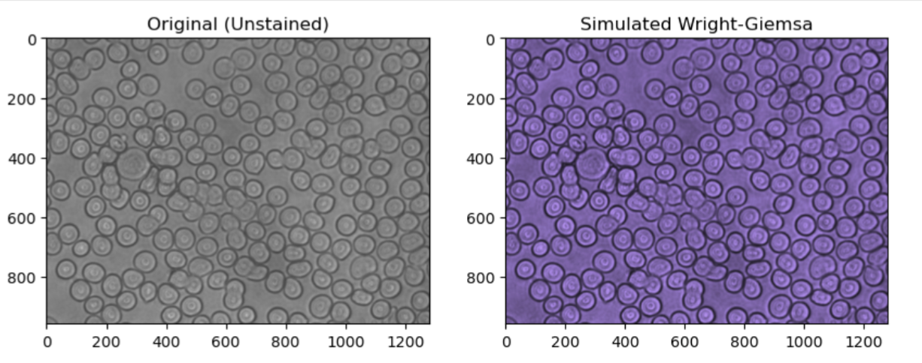
Testing on the data we collected in lab

Slide 9

Experimental Pipeline Overview
Sample Collection (capillary blood via finger prick)
Dilution (to avoid clumping and overlapping of cells)
Slide Preparation – no smearing, just drop and cover
Image Capture:
Microscope images before and after staining
DHM images (same FOV)
Staining with Wright-Giemsa
Model Inference (YOLO-based detection)
Volume Estimation of RBCs
Validation using CBC report

Slide 10
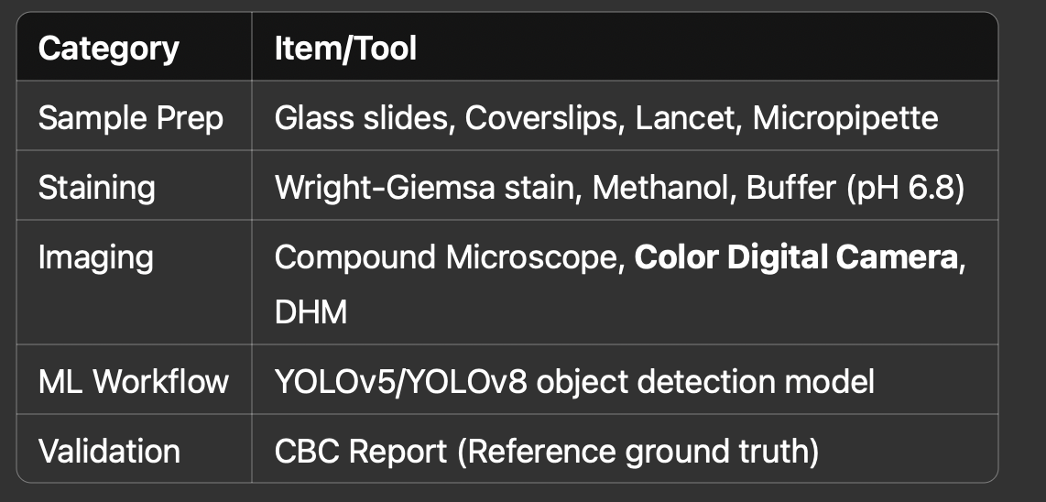
Apparatus and Solutions to be Used

Slide 11
Why Wright-Giemsa Stain?
Standard staining used in BCCD (Blood Cell Count Dataset) – allows direct comparison with benchmark datasets and online models.
Stains both cytoplasm and nucleus, enabling clear differentiation of WBC types.
Helps reduce manual annotation load—pre-labeled images available online.
High contrast & reproducibility of cellular structures.
Enables better integration with ML pipeline already trained on similar data.

Slide 12
Mathematical Processing
Dilution Step:
Assume: 1 drop of blood ≈ 20 µL
Mixed with 9 drops of phosphate buffer → 1:10 dilution
Shrinkage Correction for RBC Volume:
Cells shrink due to fixation and staining
Measure RBC diameter before (unstained/DHM) and after staining
Let:
D_u = Diameter in unstained image (DHM)
D_s = Diameter in stained image
S = {D_u}/{D_s} = Shrinking factor
Final volume (corrected):
V_{scaled} = V_ {measured}}*S^3
(Volume scales with the cube of diameter scaling)

Slide 13
Potential Challenges
incorrect volume estimates(due to taking DHM after staining)
Cell mapping between microscopic and DHM images (same FOV)
Cell shrinkage due to staining and fixing
Labeling burden if staining inconsistent
Image noise/artifacts in DHM or staining unevenness

Slide 14
Validation Plan
Use CBC machine-generated report as ground truth
Compare:
RBC Count (manual vs model)
RBC Volume estimation (from DHM + scaling)
Platelet, WBC counts
Accuracy =
{Accuracy} = {{Model Count} - {CBC Count}}/{CBC Count*100%

Slide 15
Future Goals:
⚕️ Estimate hemoglobin levels and detect anomalies (e.g., anemia, leukemia)
🧪 Develop a portable CBC diagnostic kit using minimal blood volume
🌐 Deploy as a web/mobile interface for clinics
Additional CBC Parameters We Can Extract Now
RDW (Red Cell Distribution Width)
WBC Differential Count
MPV (Mean Platelet Volume)
MCV (Mean Corpuscular Volume)

